Slide 1
Particle Filter Navigation
Lecture 10-2
RBE500-F17
Adj. Prof. Center

Slide 2
Two localization problems
“Global” localization
  figure out where the robot is, but we don’t know where the robot started
  Sometimes called the “kidnapped robot problem”
“Position tracking”
  figure out where the robot is, given that we know where the robot started

Slide 3
Markov Localization
Key idea: compute a probability distribution over all possible positions in the environment.
  This probability distribution represents the likelihood that the robot is in a particular location.
P(Robot Location)
Y
State space = 2D, infinite #states
X

Slide 4
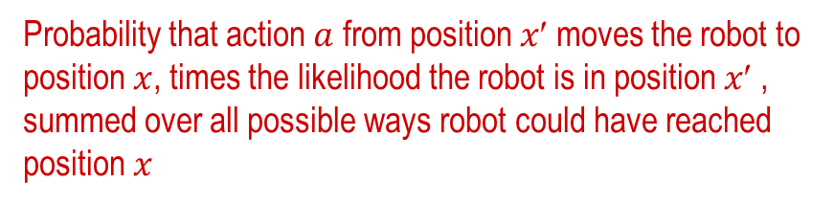
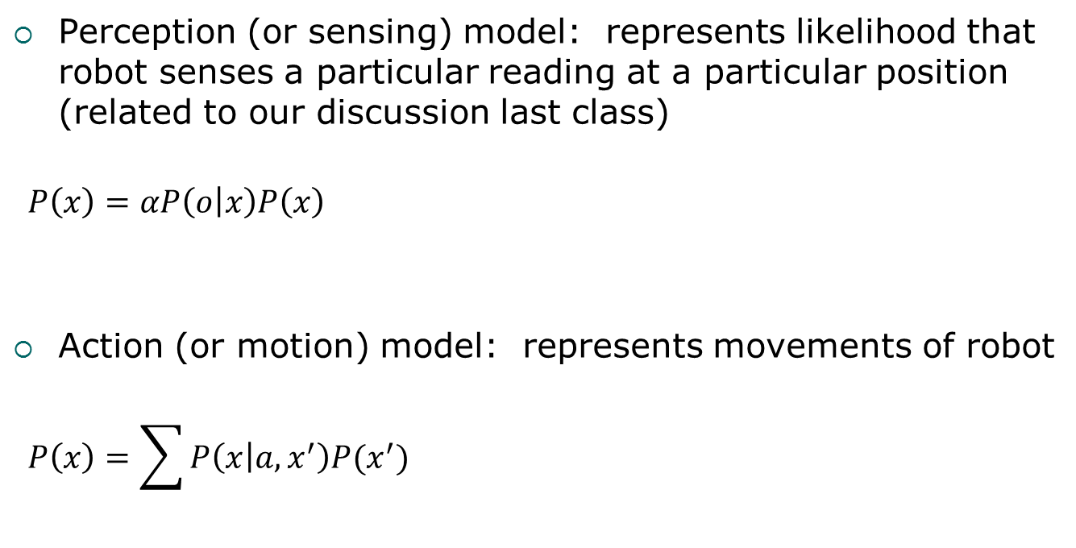
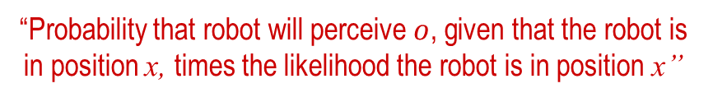
Markov Localization – Particle Filtering
Perception (or sensing) model: represents likelihood that robot senses a particular reading at a particular position (related to our discussion last class)
$$P\left(x\right)=αP\left(o | x\right)P\left(x\right)$$
Action (or motion) model: represents movements of robot
$$P\left(x\right)=\sum{P\left(x | a,x^{′}\right)P(x^{′}) }$$
“Probability that robot will perceive $o$, given that the robot is in position x, times the likelihood the robot is in position x”
Probability that action $a$ from position $x$ moves the robot to position $x$, times the likelihood the robot is in position $x$ , summed over all possible ways robot could have reached position $x$

Slide 5
Localization
Gain Information
Lose
Information
Sense
Move
Initial Belief

Slide 6
Particle Filter
Represent the belief that a robot is at a particular location by a set of “samples”, or “particles”
    Represent p(x) by set of N weighted, random samples, called particles:
    where a sample, s_{i} , is of the form: <<x, y, θ>, p>
    <x, y, θ> represents robot’s position
    p represents a weight, where sum of all p’s is 1 (analogous to discrete probability)
Allows us to:
  Maintain multiple estimates of robot’s location
  Track possible robot positions, given all previous measurements

Slide 7
A.K.A. Monte Carlo Localization (MCL)
Why “Monte Carlo”??
  Refers to techniques that are stochastic / random / non-deterministic
  Used in lots of modeling and simulation approaches

Slide 8
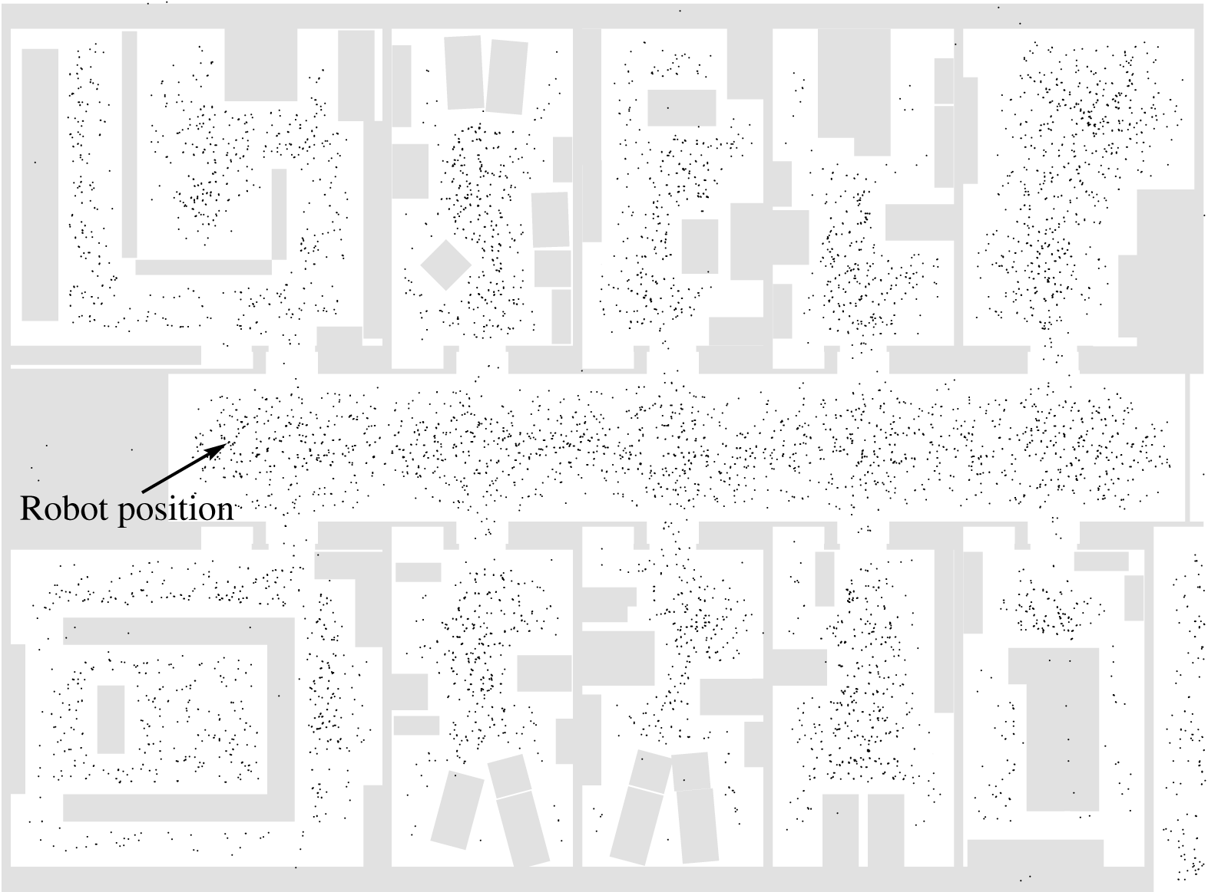
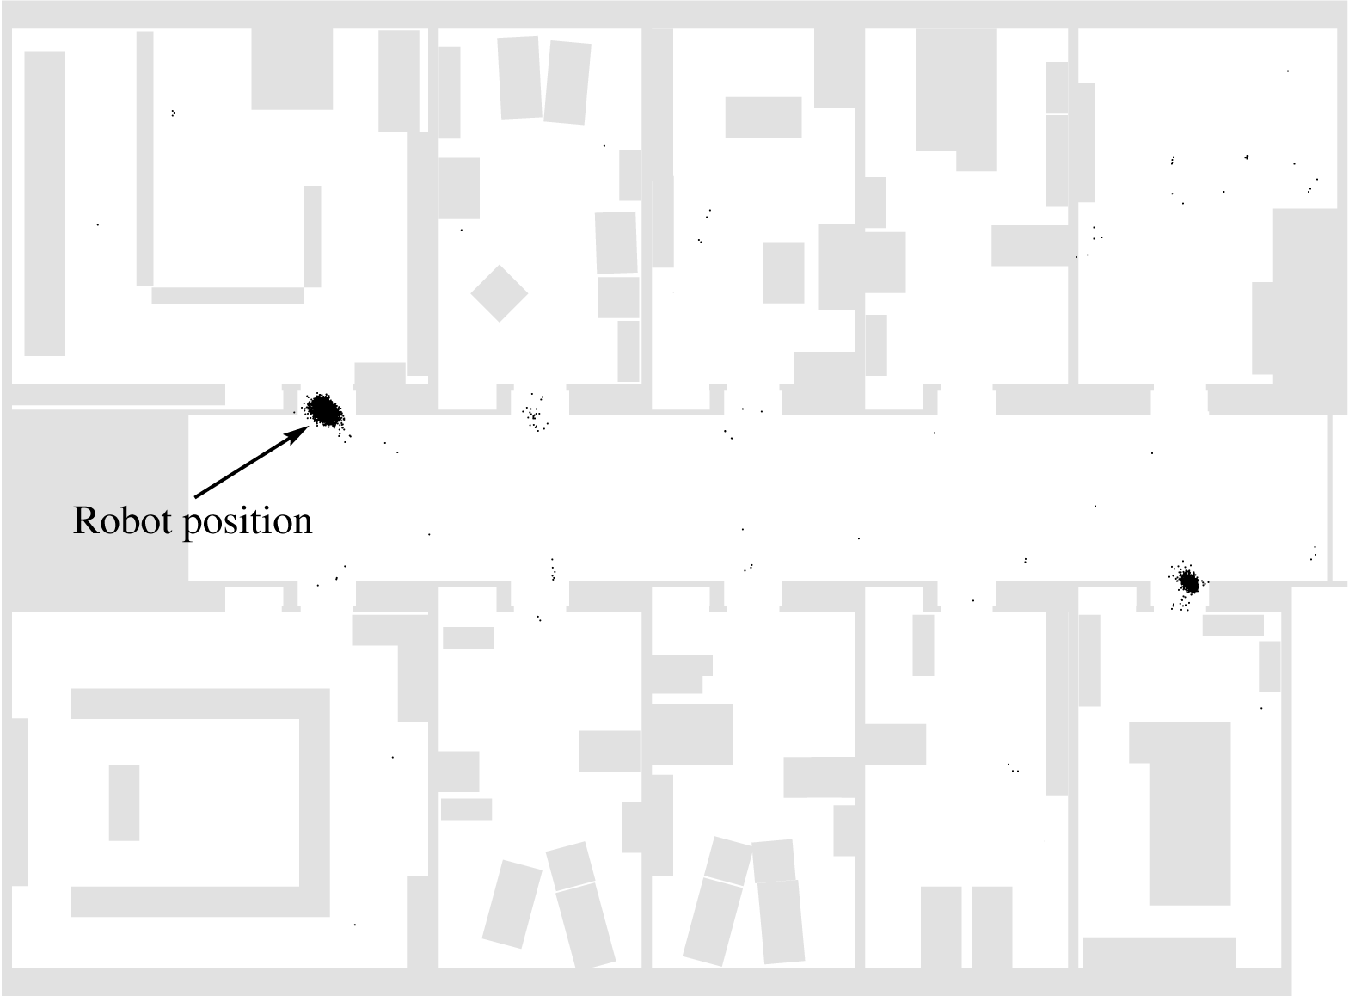
Particle Filtering Overview
After robot moves some and takes measurements, it gets better estimate (see particles clustered an a few areas, with a few random particles also distributed around for robustness)
Initially, robot doesn’t know where it is
(see particles representing possible robot locations distributed throughout the environment)

Slide 9
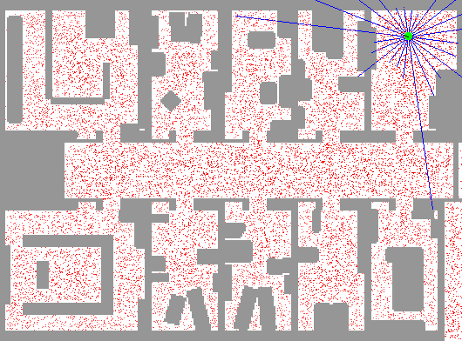
Particle Filter Localization (using sonar)
http://www.cs.washington.edu/ai/Mobile_Robotics//mcl/animations/global-floor-start.gif

Slide 10

Particles
Each particle is a guess about where the robot might be
$$\begin{matrix}x \\ y \\ θ\end{matrix}$$

Slide 11

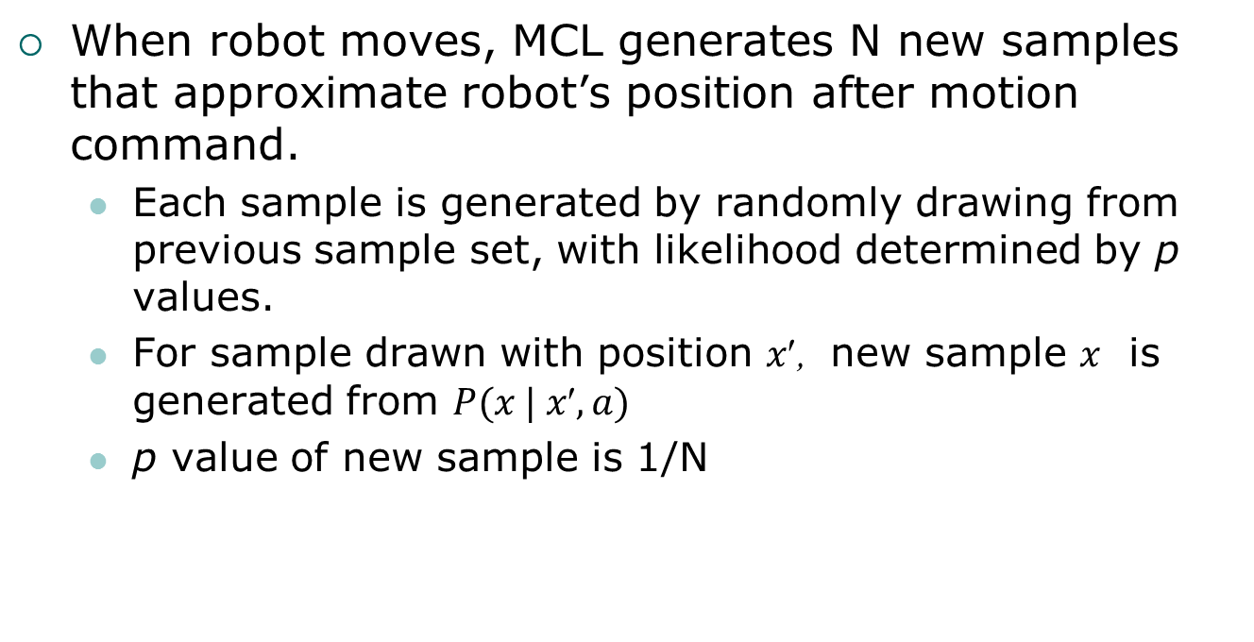

Motion Model
When robot moves, MCL generates N new samples that approximate robot’s position after motion command.
  Each sample is generated by randomly drawing from previous sample set, with likelihood determined by p values.
  For sample drawn with position $x$, new sample $x$ is generated from $P(x | x, a)$
  p value of new sample is 1/N
$n$ particles
$n$ particles

Slide 12
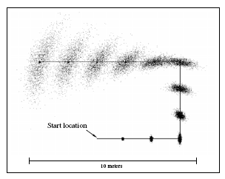
Example
Example data from a non-sensing, driving robot

Slide 13
Sensing Model
Re-weight sample set, according to the likelihood that robot’s current sensors match what would be seen at a given location
  Let < x, p> be a sample.
  Then, p ← α P(s | x)
    s is the sensor measurement;
    α is a normalization constant to enforce the sum of p’s equaling 1

Slide 14

Incorporating Sensing

Slide 15
Incorporating Sensing
Difference between the
actual measurement
and the
estimated measurement
Importance weight

Slide 16
Importance weight pseudocode
Calculate the probability of a sensor measurement for a particle:
prob = 1.0;
for each landmark
d = Euclidean distance to landmark
prob *= Gaussian probability of obtaining a reading at
distance d for this landmark from this particle
return prob

Slide 17
Incorporating Sensing

Slide 18
Resampling
After applying Motion model and Sensing model:
  Resample, according to latest weights
  Add a few uniformly distributed, random samples
    Very helpful in case robot completely loses track of its location

Slide 19

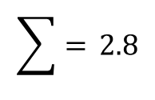
Resampling
$n$ original particles
Importance Weight $$w(x_{i})$$
0.2
0.6
0.2
0.8
0.8
0.2
$$\sum{=} 2.8$$

Slide 20
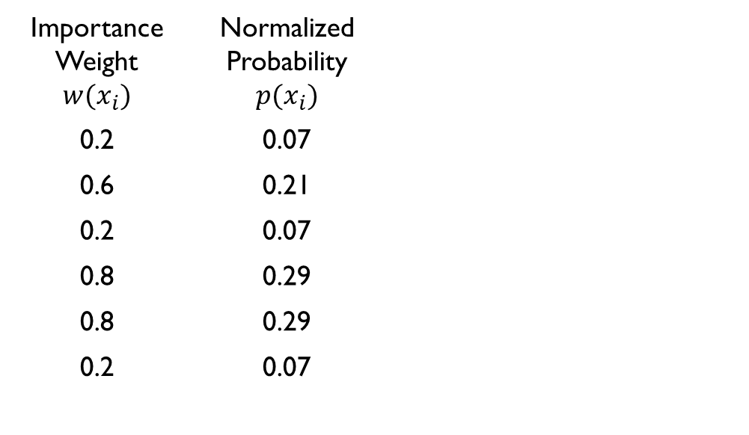
Resampling
$n$ original particles
Importance Weight $$w(x_{i})$$ | Normalized Probability $$p(x_{i})$$
0.2 | 0.07
0.6 | 0.21
0.2 | 0.07
0.8 | 0.29
0.8 | 0.29
0.2 | 0.07
$$\sum{=} 2.8$$

Slide 21
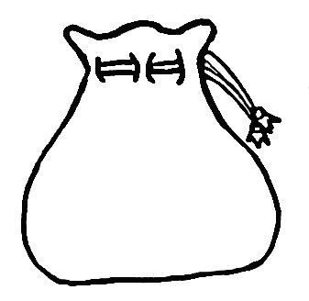
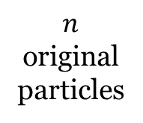
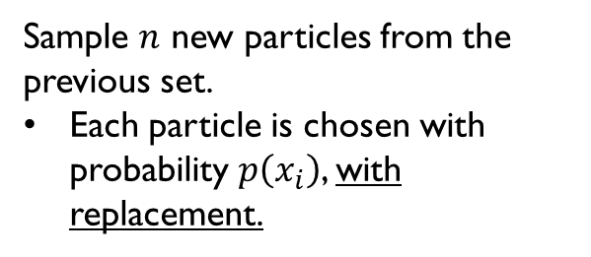
Resampling
$n$ original particles
Importance Weight $$w(x_{i})$$ | Normalized Probability $$p(x_{i})$$
0.2 | 0.07
0.6 | 0.21
0.2 | 0.07
0.8 | 0.29
0.8 | 0.29
0.2 | 0.07
Sample $n$ new particles from the previous set.
Each particle is chosen with probability $p\left(x_{i}\right)$, with replacement.
$$\sum{=} 2.8$$

Slide 22
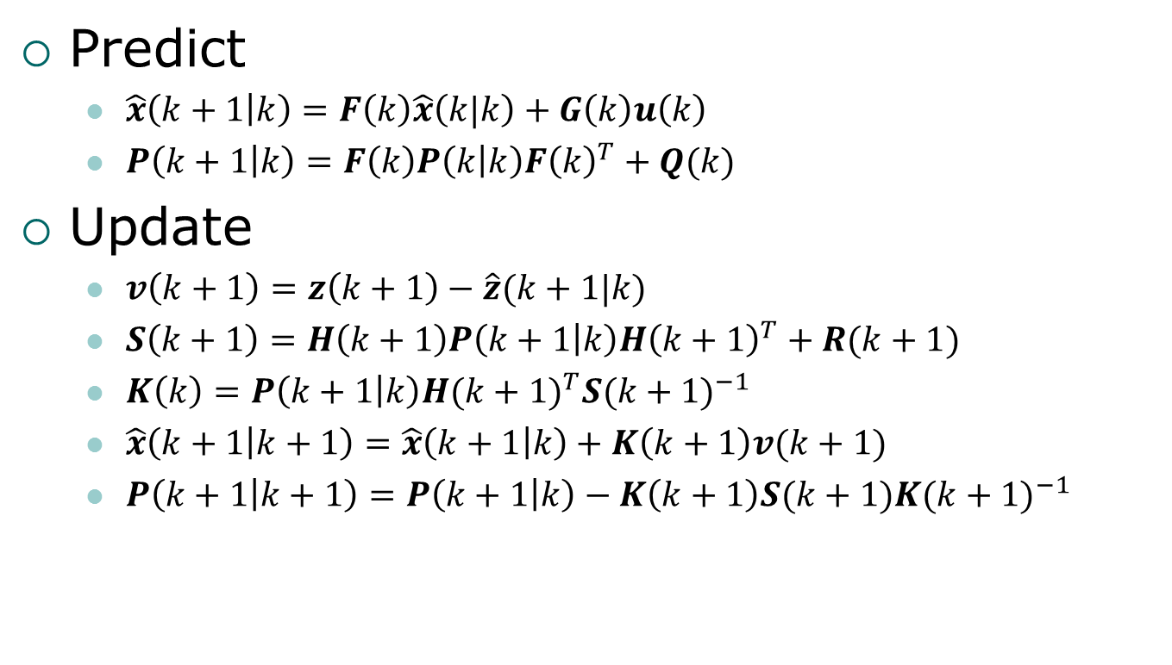
Resampling
Is it possible that one of the particles is never chosen?
Yes!
Is it possible that one of the particles is chosen more than once?
Yes!
$n$ original particles
Importance Weight $$w(x_{i})$$ | Normalized Probability $$p(x_{i})$$
0.2 | 0.07
0.6 | 0.21
0.2 | 0.07
0.8 | 0.29
0.8 | 0.29
0.2 | 0.07
Sample $n$ new particles from the previous set.
Each particle is chosen with probability $p\left(x_{i}\right)$, with replacement.
$$\sum{=} 2.8$$

Slide 23
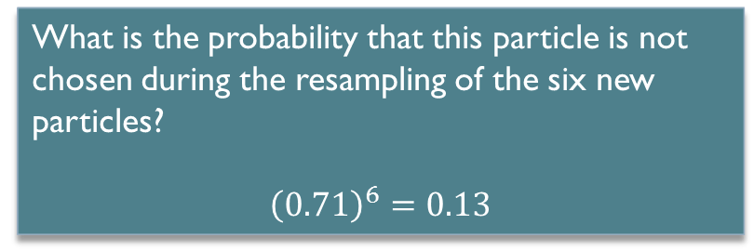
Resampling
What is the probability that this particle is not chosen during the resampling of the six new particles?
$${\left(0.71\right)}^{6}=0.13$$
$n$ original particles
Importance Weight $$w(x_{i})$$ | Normalized Probability $$p(x_{i})$$
0.2 | 0.07
0.6 | 0.21
0.2 | 0.07
0.8 | 0.29
0.8 | 0.29
0.2 | 0.07
Sample $n$ new particles from the previous set.
Each particle is chosen with probability $p\left(x_{i}\right)$, with replacement.
$$\sum{=} 2.8$$

Slide 24
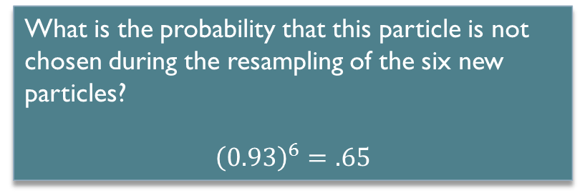
Resampling
What is the probability that this particle is not chosen during the resampling of the six new particles?
$${\left(0.93\right)}^{6}=.65$$
$n$ original particles
Importance Weight $$w(x_{i})$$ | Normalized Probability $$p(x_{i})$$
0.2 | 0.07
0.6 | 0.21
0.2 | 0.07
0.8 | 0.29
0.8 | 0.29
0.2 | 0.07
Sample $n$ new particles from the previous set.
Each particle is chosen with probability $p\left(x_{i}\right)$, with replacement.
$$\sum{=} 2.8$$

Slide 25
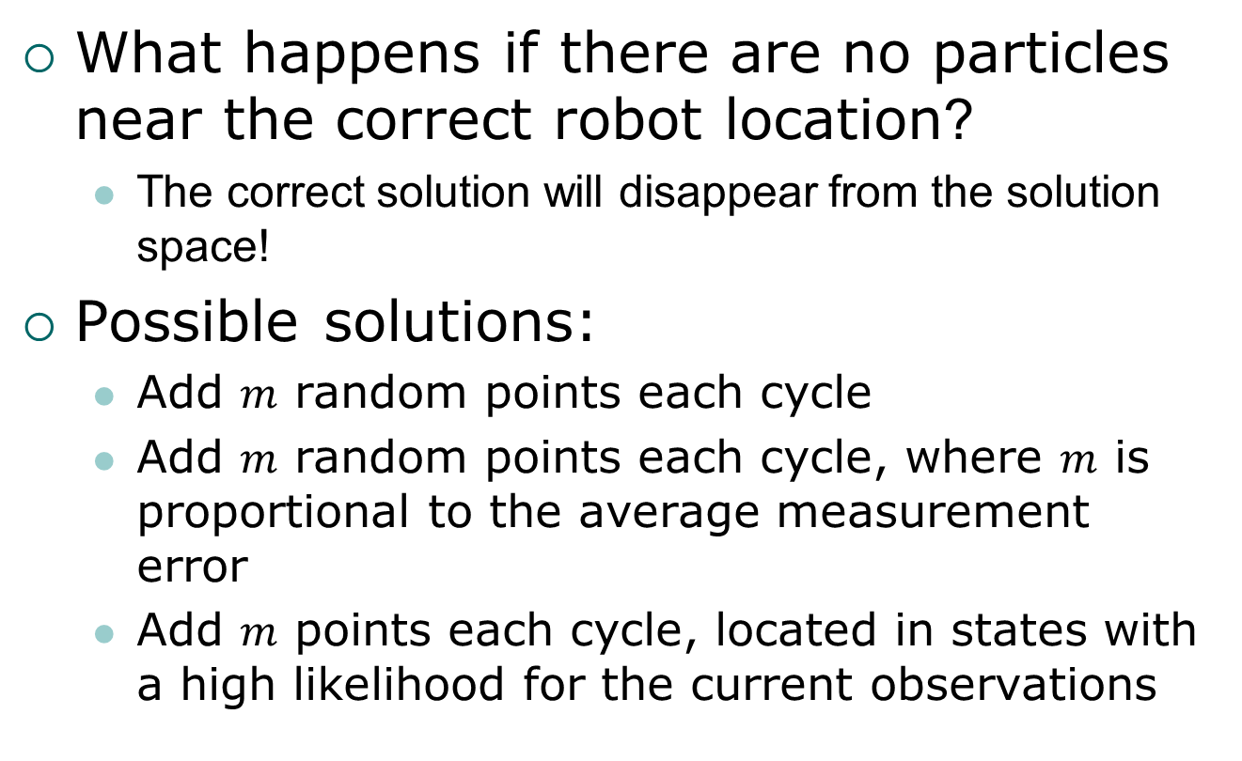
Question
What happens if there are no particles near the correct robot location?
  The correct solution will disappear from the solution space!
Possible solutions:
  Add $m$ random points each cycle
  Add $m$ random points each cycle, where $m$ is proportional to the average measurement error
  Add $m$ points each cycle, located in states with a high likelihood for the current observations

Slide 26

A Short Video Example
https://www.youtube.com/watch?v=10tvdmZ7OqU

Slide 27
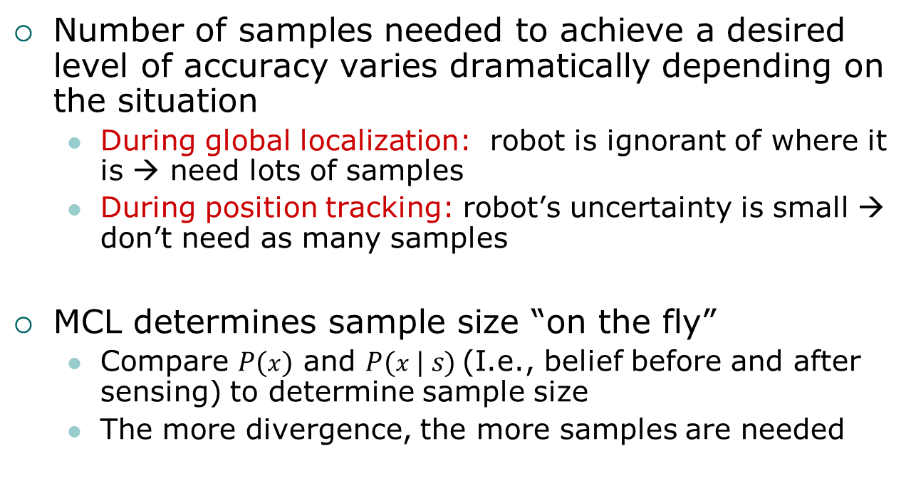
Number of Samples
Number of samples needed to achieve a desired level of accuracy varies dramatically depending on the situation
  During global localization: robot is ignorant of where it is → need lots of samples
  During position tracking: robot’s uncertainty is small → don’t need as many samples
MCL determines sample size “on the fly”
  Compare $P(x)$ and $P(x | s)$(I.e., belief before and after sensing) to determine sample size
  The more divergence, the more samples are needed

